Slide 1



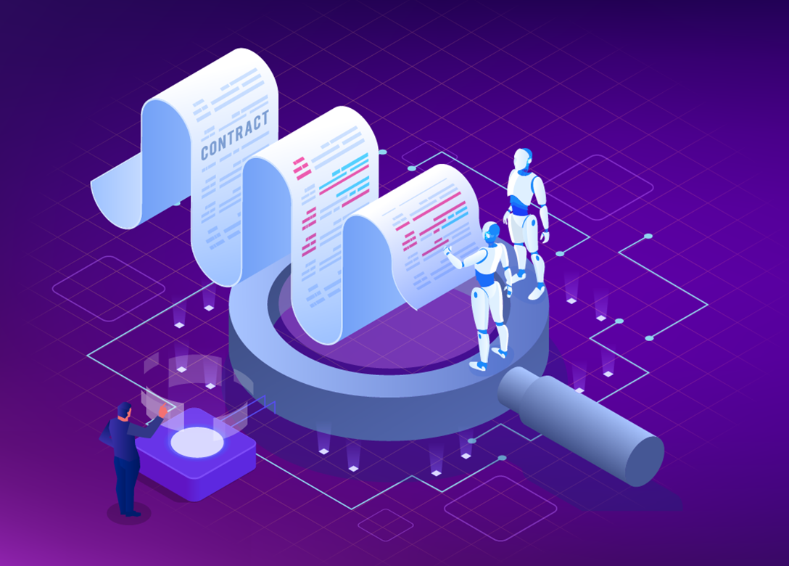


LEGAL AI ASSISTANT
Generate formatted legal contract using textual prompts
Regenerate any portion of contract using prompt
Summarize entire contract on a single click

